Slide 1

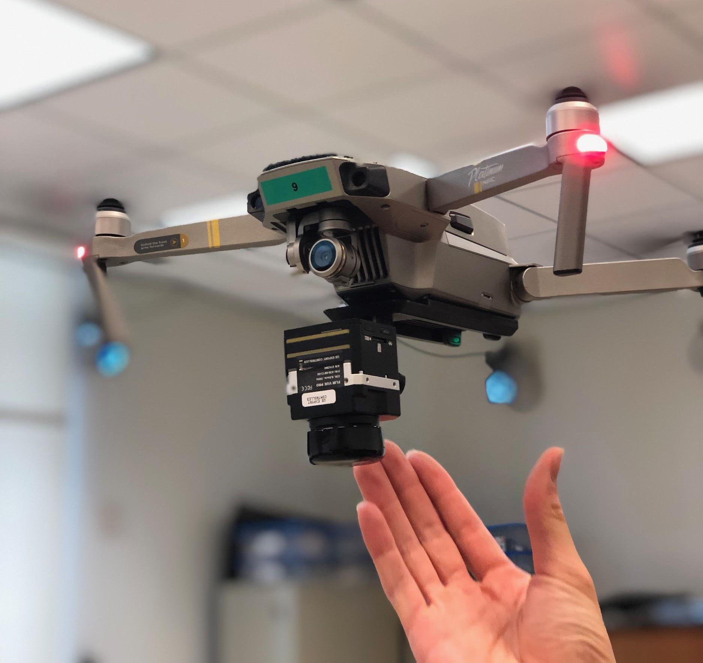
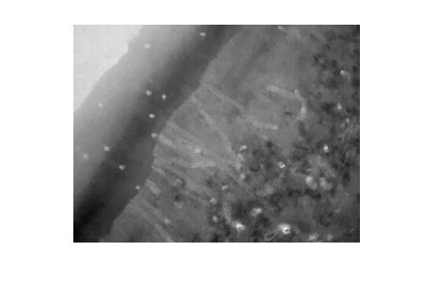
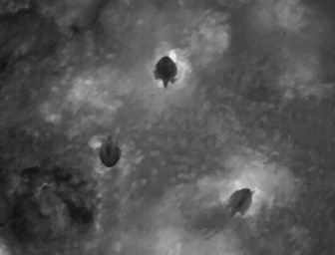
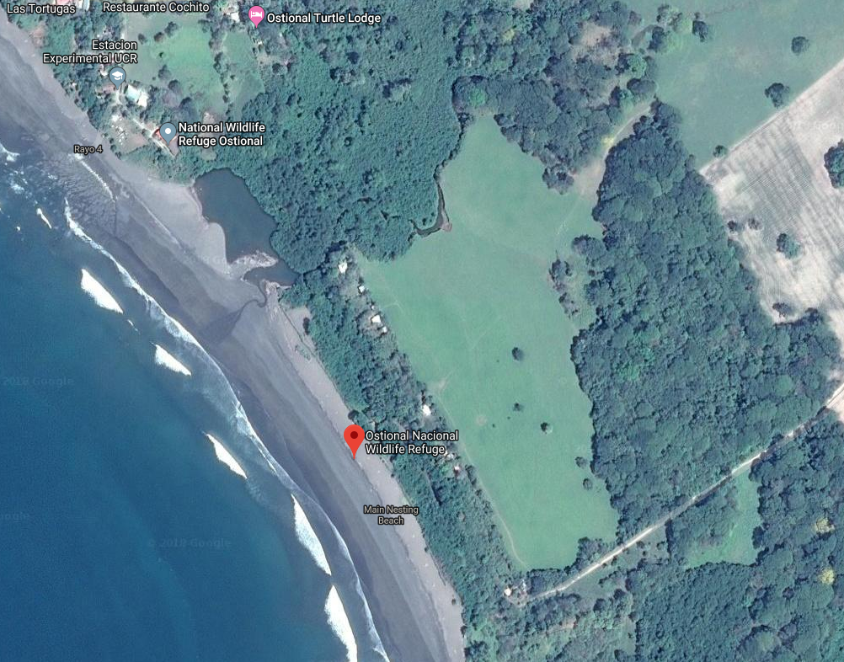
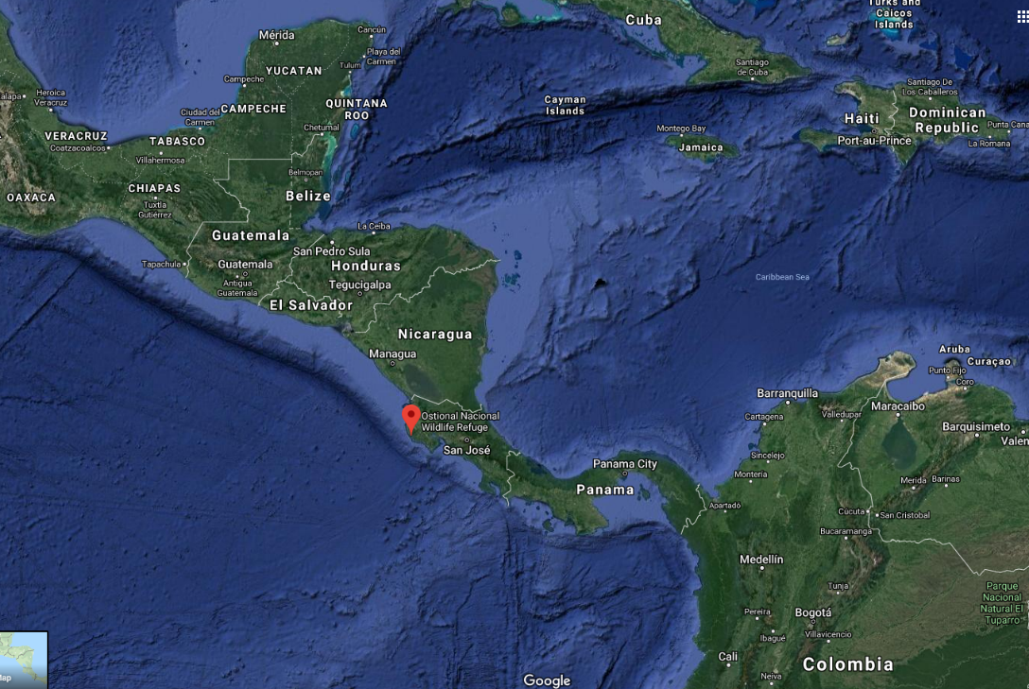
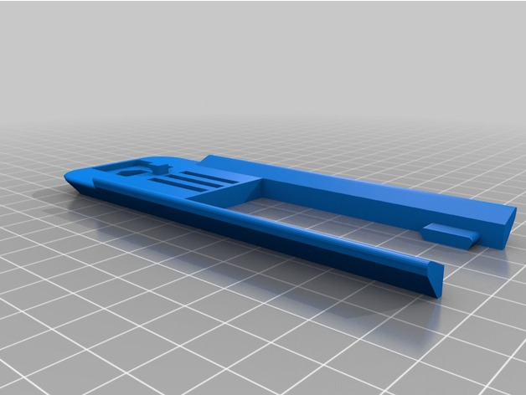
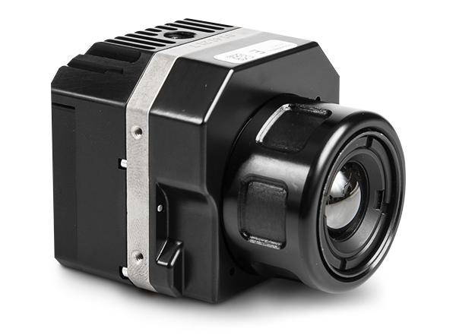
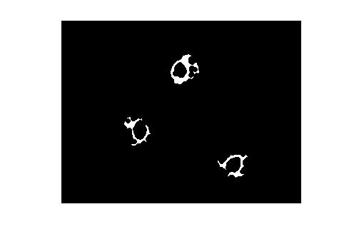
Affordable Unmanned Aerial Systems, Sensors, Modular Payloads, and Algorithmic Tools for Ecological Study
S Nemani, C Edwards, M Hall, W Martin, and D Evangelista (evangeli@usna.edu)
Department of Weapons, Robotics, and Control Engineering, United States Naval Academy
Abstract: Ecological and conservation efforts are often complicated by the need to gather data in remote areas such that researchers often cite the size, behavior or location of these populations as a major impediment to their population surveys. In military missions, unmanned aerial systems (UAS) have been instrumental in providing remote access and persistent presence. We will discuss an ongoing design effort to develop affordable UAS designs as well as sensors and modular payloads aimed at supporting science and military missions.
Methods and Materials
Fly sensors (payloads) over target area of interest
Analyze imagery using machine vision methods
Visible light (4K, GoPro)
Thermal / IR (FLIR)
Active IR (mod GoPro/Runcam w/emitter)
Additional counts for ground truth
Collect additional environmental data (weather, wind and water, illumination, white balance, nav aids for registration)
Modular Payloads
Fixed wing (Flitetest derivative) spare also under development
Deployment: March 2019
Field testing in Maryland, followed by deployment to Costa Rica in March 2019 conducted to film Olive Ridley arribada
Ostional, Costa Rica
Obtain aerial imagery of sea turtles nesting
Third quarter lunar phase
Local field testing to develop training set for automatic turtle detection and counting.
Inflatable sea turtle training shapes (Intex Co; Long Beach, CA).
This work was carried out under Costa Rican permit number ACT-OR-DR-026-2019.
DJI Mavic Pro
4K Gimballed Camera
Water
Dry sand
Undisturbed sand
Turtles
Wet sand
FLIR Vue Pro
source: https://www.thingiverse.com/thing:1997900
3D printed base mount for Mavic
Turtles
25 ft
Disturbed sand
5 ft
2000 ft
Thermal image at 150 ft of the Arribada taken by our team at the nesting site in Ostional, Costa Rica
Thermal image of Olive Ridley Sea Turtles (Lepidochelys olivacea)
source: https://www.flir.com/products/vue-pro/
Using UAS and machine vision to get accurate counts
Governments and conservation authorities rely on accurate population surveys to regulate and inform policy.
Population counts are generally obtained through sampling or estimation, since it is very difficult to get eyes on every member of a population.
Manual counting is laborious and time intensive; may require subsampling along transects and application of other estimation techniques.
Can UAS with modular payloads and machine vision techniques help?
Edge Detection Pseudocode
while 1
convert to grayscale
calculate gradients in x and y
find gradients of magnitude > 80
close and open to connect pixels
eliminate blobs with pixels < 100
end
FLIR Vue Pro
Satellite Images of the flight path in Ostional Wildlife Refuge, Main Nesting Beach, Costa Rica. Source: Google Maps
5 ft
Acknowledgements: We thank Dr V Bezy, UNC; Prof. Broussard, USNA; CAPT T Robertson, USN; ENS C Garcia, USN. We also thank the staff at Ostional, Costa Rica, USNA ES281C “School of Drones” Fall 2018 class, 3/C D Garcia, and Prof M Schroeder / USNA Research. Sponsors are Lockheed Martin and USNA.
OpenCV is an open source software library for computer vision in Python or C++
MATLAB can be used for processing gradients as well.
Blob and Edge Detection
Shape (moments)
Color or brightness
Machine Learning
Haar Cascade w training, validation sets
Register and combine multi-spectral
References
[1] Bézy, V.S., Girondot, M., and R.A. Valverde. 2016. A new method for estimating nest density at an arribada rookery in Ostional, Costa Rica. Journal of Herpetology. doi: 10.1670/14-152.
[2] Sykora-Bodie, S. T., Bezy, V., Johnston, D. W., Newton, E. and Lohmann, K. J. (2017). Quantifying nearshore sea turtle densities: applications of unmanned aerial systems for population assessments. Scientific Reports 7, 17690. doi:10.1038/s41598-017-17719-x.
Thermal image processed with edge detection

